Slide 1

Biocompatibility Testing
Louisiana Tech University
College of Engineering and Science
BIEN 235
Dr. Teresa Murray

Slide 2
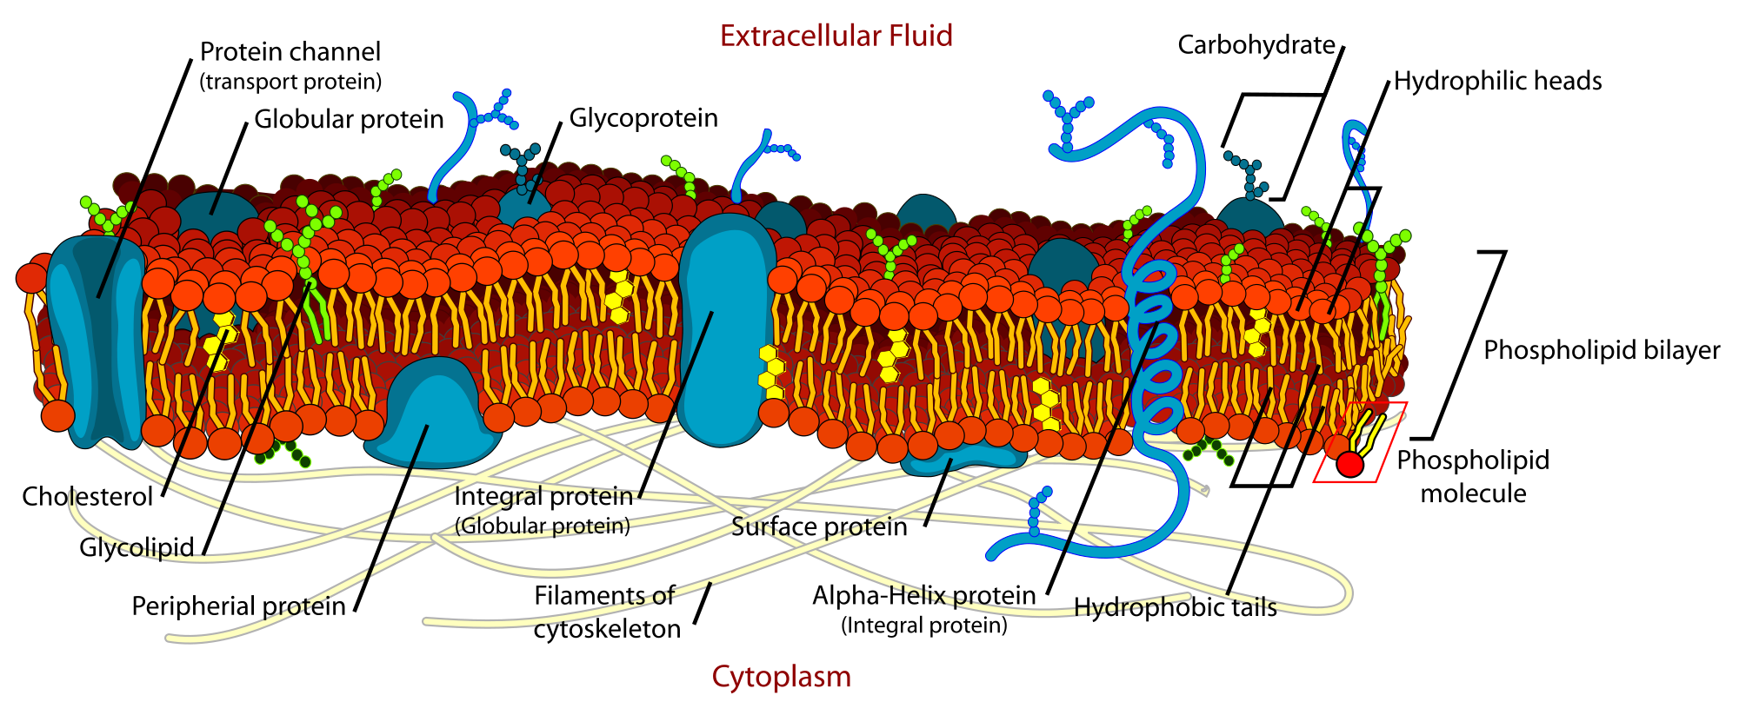
Membrane of Cells
Part II MEDICAL
Chap 16 Cell
All cells are bounded by a membrane called plasma membrane, which serves as a dynamic interface between the internal environment of the cell and the external environments.
Cell Structure: http://www.youtube.com/watch?v=PXbv95P3uhI
http://www.youtube.com/watch?v=fNyq4A08mTo
http://espanol.video.yahoo.com/watch/40408/808847

Slide 3
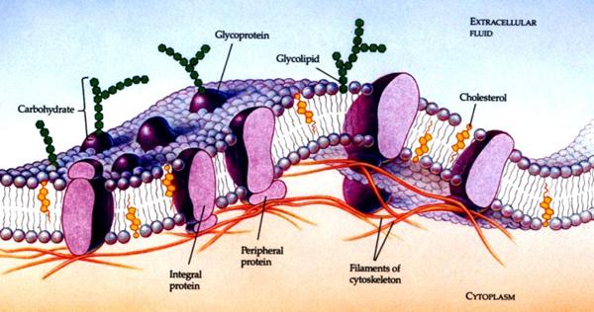
Receptors
Part II MEDICAL
Chap 16 Cell
On the external surface of the plasma membranes, many of the membrane proteins and lipids are conjugated with short chains of polysaccharide, the combinations called glycoprotein and glycolipids
These glycoprotein and glycolipids are called receptors. They participate in important interactions such as cell adhesion, recognition and response to protein hormones (cell communication).

Slide 4
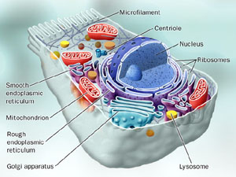
Nucleus, Cytoplasm, Cytoskeleton
Part II MEDICAL
Chap 16 Cell
Inside cell membrane, the cell is composed of three basic parts: nucleus,
cytoplasm & cytoskeleton
Both the cytoplasm and nucleus contain a number of sub-cellular elements, called organelles.

Slide 5
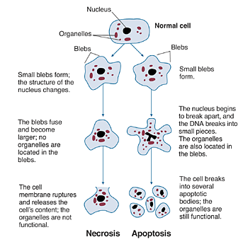
Apoptosis vs Necrosis
Part II MEDICAL
Chap 16 Cell
Either apoptosis or necrosis can be identified morphologically using histological techniques

Slide 6
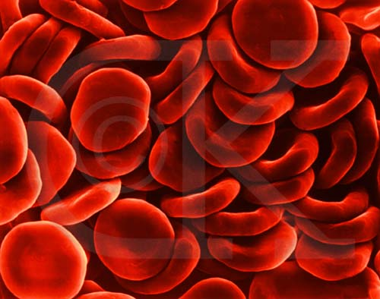
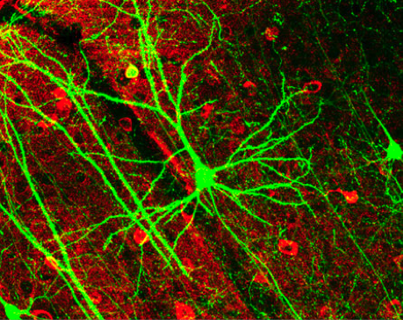
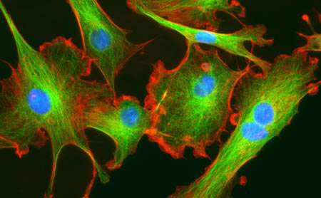
Phenotype
Part II MEDICAL
Chap 16 Cell
A phenotype is any observable characteristic (or traits) of an organism (including cells): such as its morphology, development, biochemical or physiological properties, or behavior.
Red blood cells
Neuron
Fibroblasts

Slide 7
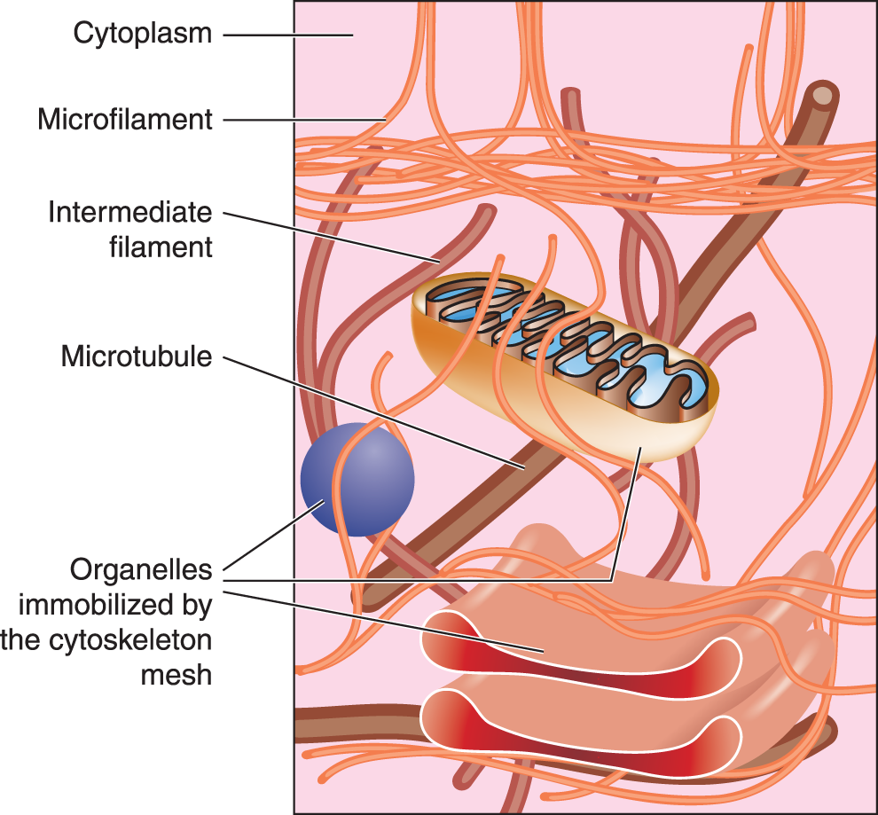
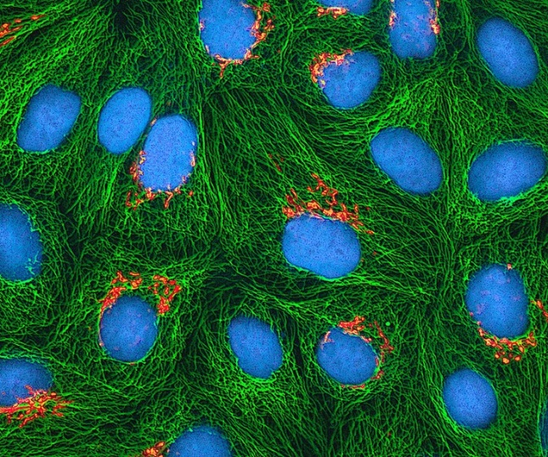
Cytoskeleton
Part II MEDICAL
Chap 16 Cell
Within the cytosol, there is a network of minute tubules and filaments, collectively known as the cytoskeleton, which provides structural support for the cell and its organelles, as well as providing a mechanism for transfer of materials within the cell and movement of the cell itself.

Slide 8
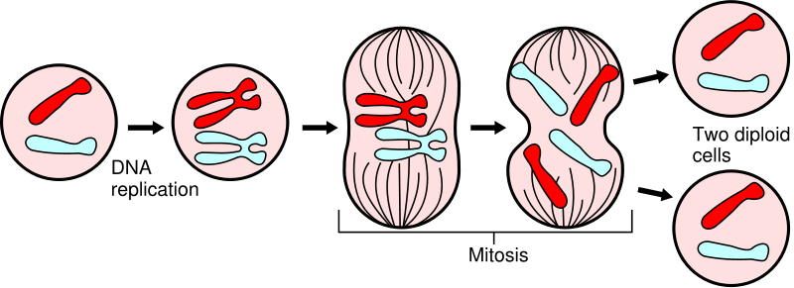
Mitosis
Part II MEDICAL
Chap 16 Cell
Cell division is also called mitosis.
Video of cell division:
http://www.youtube.com/watch?v=aDAw2Zg4IgE
http://www.youtube.com/watch?v=rgLJrvoX_qo

Slide 9
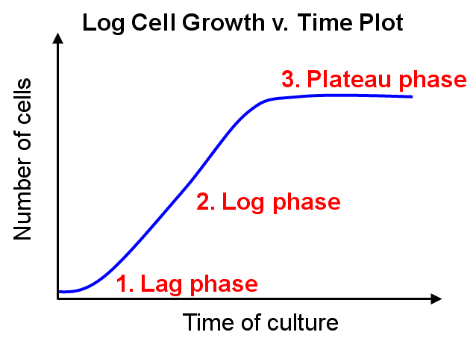
Cell Growth Curve
Part II MEDICAL
Chap 16 Cell
Cell proliferation has been observed to occur in three phases, called lag, log and plateau phase.
The doubling time is the period required for a population of cells to double in number.
Growth dynamics occurs under controlled growth conditions in vitro, in an excess of nutrients. The lag phase an artefact of the relatively slow recovery of cells from cryostorage. However, similar proliferation dynamics occur in vivo as well.

Slide 10
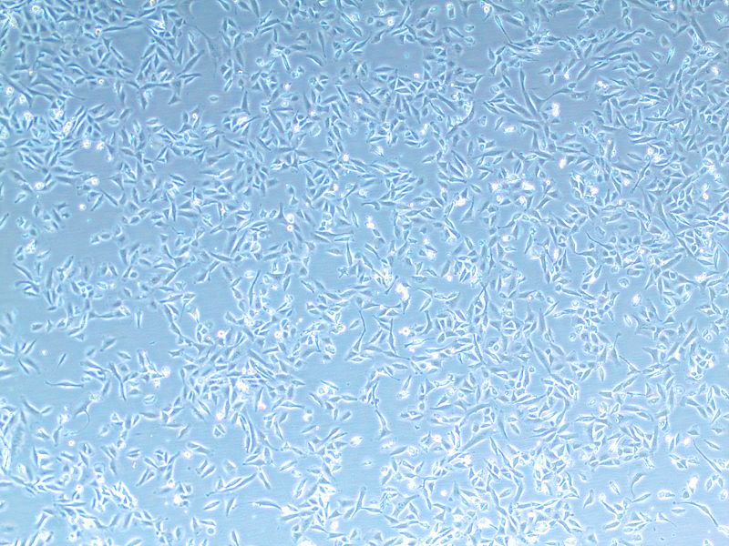
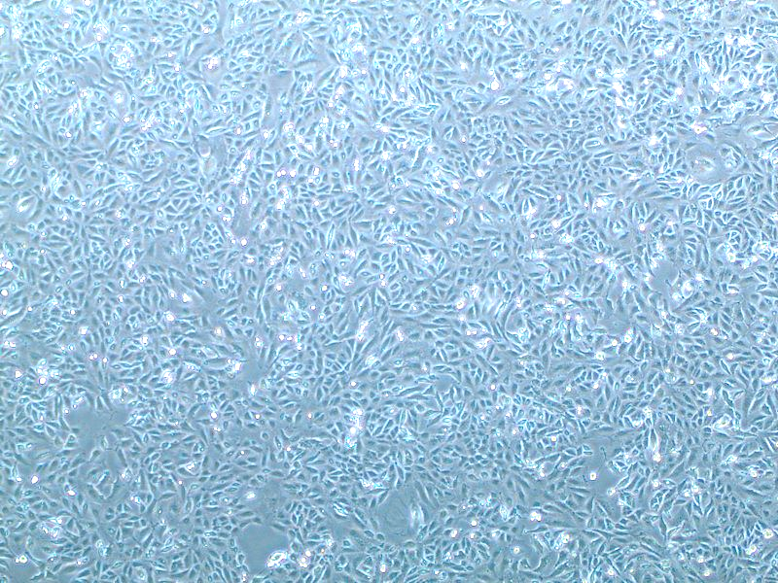
Confluency
Part II MEDICAL
Chap 16 Cell
50 - 60 % Confluency
100 % Confluency

Slide 11
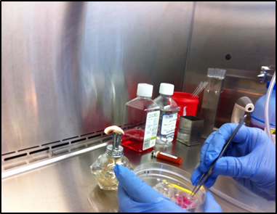
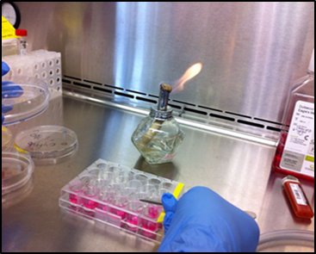
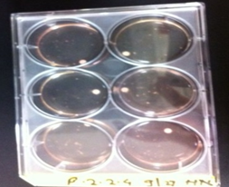
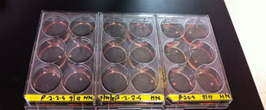
Selection of Stable transfected Cell Lines
a. Picked individual clonal colonies by using cloning disks
b. Placed cloning disk into 6 well plate containing CDMEM with hygro
c. Formation of β2.2.4-nAChRs clonal colonies

Slide 12
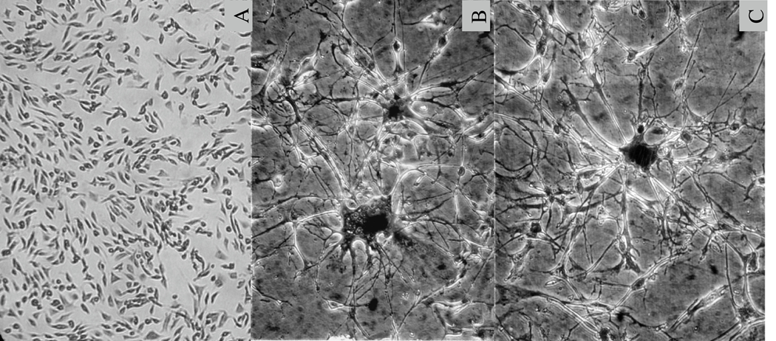
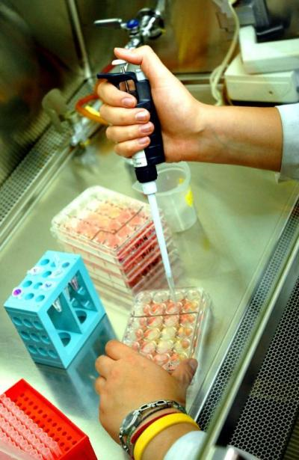
Louisiana Tech University
College of Engineering and Science
Preliminary tests of biocompatibibilty using cell culture
Temperature, nutrient and pH controlled
www.translational-medicine.com/content/figures/1479-5876-3-14-1-l.jpg
Vital red: stains live cells
Trypan blue: stains dead cells
Changes in morphology: vaculoes, blebs, crenation, and rounding are examples.
http://www.biology-blog.com/images/
blogs/9-2008/cell-culture-17601.jpg

Slide 13
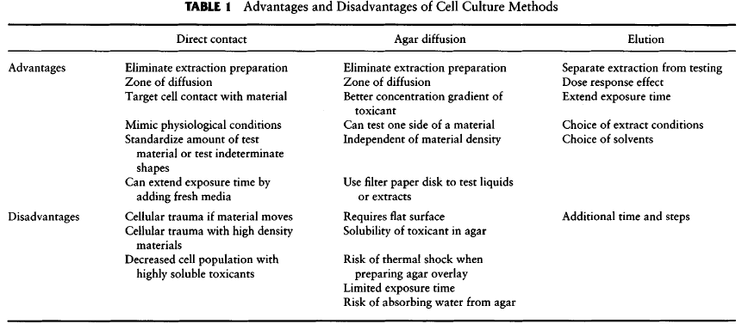
Louisiana Tech University
College of Engineering and Science
Must standardize methods for valid comparisons: number of cells, growth phase of the cells, cell type (generally, use established, well-characterized cell lines), duration of exposure, test sample size (e.g., geometry, density, shape, thickness), and surface area of test sample.
Example: A small increase in size of sample with toxic extractable chemicals could change the effect on cells from mildly toxic to very toxic.
Table and description from Ch. 5.2 text: Ratner et al., 2004

Slide 14
Receptor-mediated internalization of small molecules (e.g., Aβ₁₋₄₂)
Louisiana Tech University
College of Engineering and Science
Aβ₁₋₄₂ binds to receptor → when receptor is endocytosed, Aβ₁₋₄₂ enters cell with receptor
Aβ₁₋₄₂
Plasma
membrane
Cytosol
nACh receptor
Cytosol
Endosome
Graphics: Teresa A Murray © 2012

Slide 15

Internalization of toxic small molecules
Louisiana Tech University
College of Engineering and Science
Receptor-medicated internalization of small molecules can be toxic to cells
Cells can die or become unhealthy (poor function, cancer, …)

Slide 16
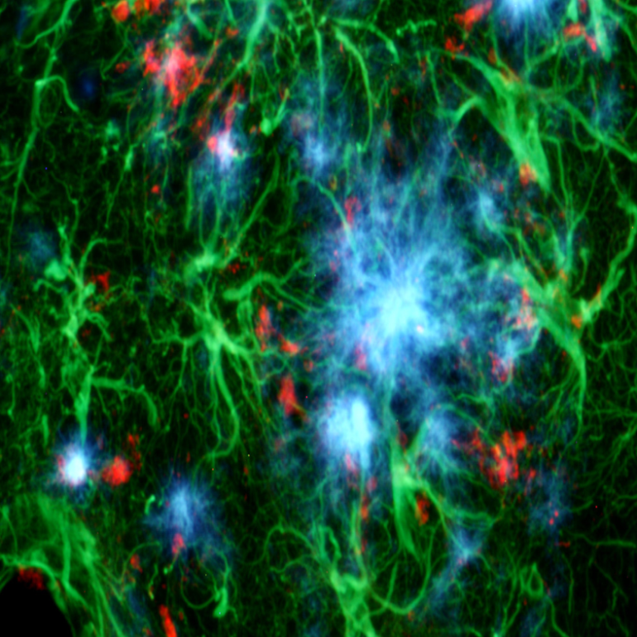
Internalization of toxic Aβ₁₋ ₄₂ peptide
Louisiana Tech University
College of Engineering and Science
Receptor-medicated internalization of small molecules, such as Aβ₁₋₄₂
Amyglo stains oligomeric Aβ₁₋₄₂ by exhibiting blue fluorescence (see image)
Source: www.biosensis.com
Notes:
Adapted from Himgauri V. Naik’s Master’s Thesis 2014

Slide 17



Amylo-Glo staining of Aβ₁₋ ₄₂
Incubate cells with 4% paraformaldehyde (cross links proteins)
Fixation
Staining
Incubation with 0.1 % Amylo-Glo staining solution in 0.9%saline
Washing
Rinse 3 times with phosphate buffered saline
Imaging
3D images of live cells by multiphoton microscopy
Analysis
Compare levels of internalization using relative intensity of staining
Notes:
Adapted from Himgauri V. Naik’s Master’s Thesis 2014

Slide 18
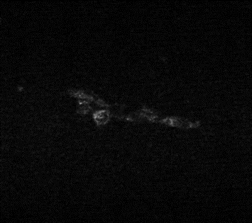
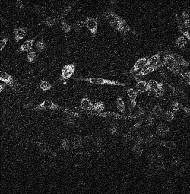
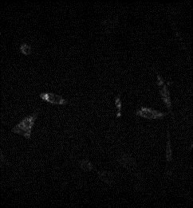
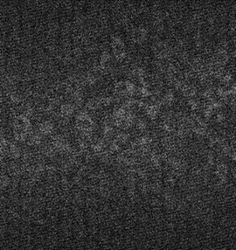
Amylo-Glo staining with and without Aβ₁₋ ₄₂
SHEP 1 cells
α7β2 nAChRs
With
Without
Scale bar 20 μm for all images
Notes:
Adapted from Himgauri V. Naik’s Master’s Thesis 2014

Slide 19
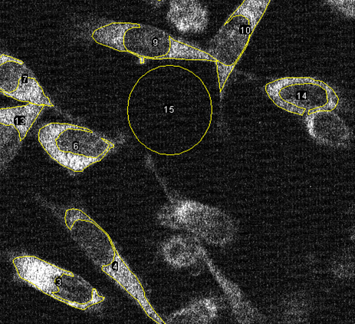
Assessing internalization of Aβ₁₋₄₂
SH-EP1 cells with … | Normalized intensity of cells incubated with Aβ₁₋₄₂
No receptors | 1.00
α7β2 nACh receptors | 2.90
α7 nACh receptors | 4.49
α7β2-nAChRs
A region of interest was drawn around each cell, excluding the nucleus, using Image J software.
Mean fluorescence intensity for cells incubated with Aβ₁₋₄₂ were normalized to (divided by) the intensity of cells with no Aβ₁₋₄₂ incubation.
SH-EP1 cells were the negative control condition and cells expressing the a7-nACh receptor were the positive control condition.
Notes:
Adapted from Himgauri V. Naik’s Master’s Thesis 2014

Slide 20
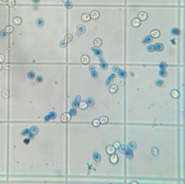

Determination Of Cell Death Rate
Incubation
Incubate cells with Aβ₁₋₄₂
Incubation
Periods
4, 12, 24, 48, 96 hour
Method
Trypan blue to stain dead cells
Imaging
Olympus DP71 color camera and a 20X objective lens
Image source: http://braukaiser.com/blog/wp-content/uploads/2013/04/fermentation_experiment_o2_access_B.jpg
Notes:
From Himgauri V. Naik’s Master’s Thesis 2014

Slide 21
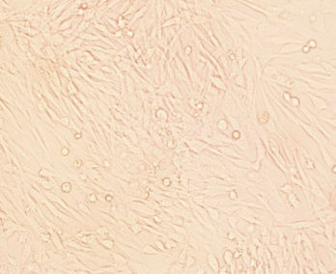
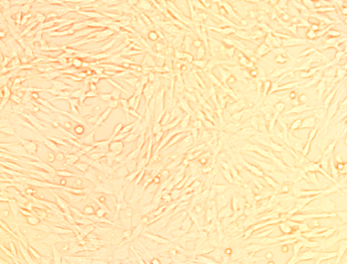
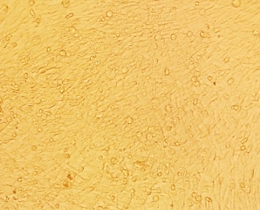
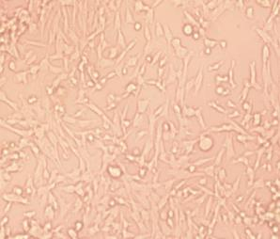
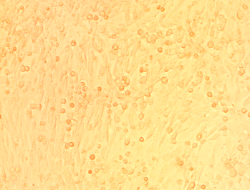
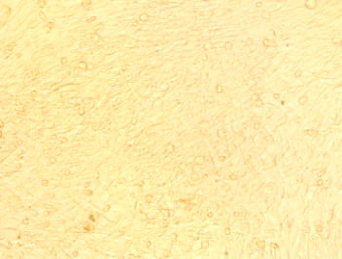
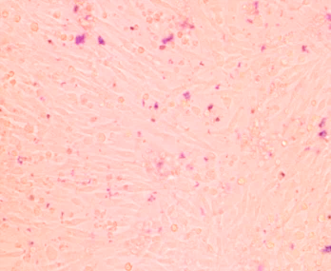
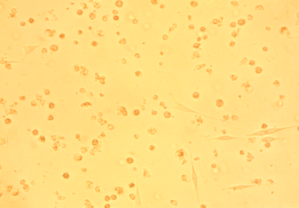
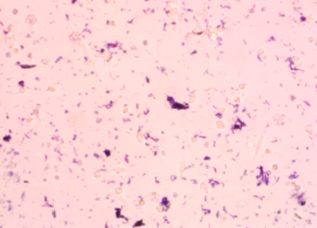
Images SH-EP1 cells with α7β2-nACh Receptors
Confluent | 24 hrs | 48 hrs | 96 hrs | 96 hr tryphan blue
Without oligomeric Aβ1-42 peptide
With oligomeric Aβ1-42 peptide
Scale bar 20 μm
Same for all images
Notes:
α7β2.2.4-nAChR expressing SH-EP1 cells (Adapted from Himgauri V. Naik’s Master’s Thesis 2014)

Slide 22
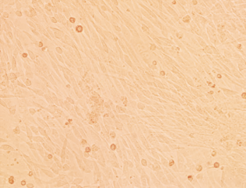
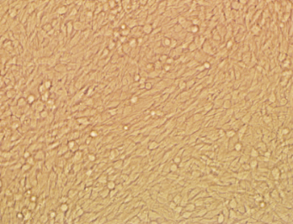
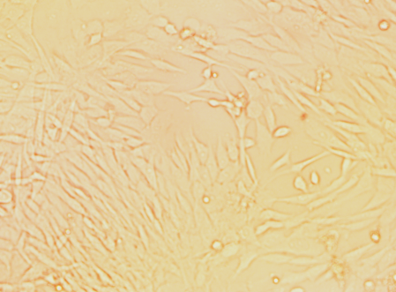
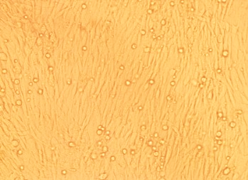
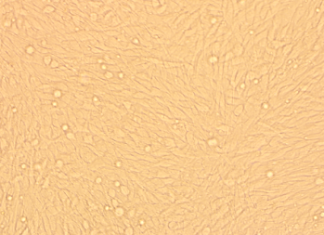
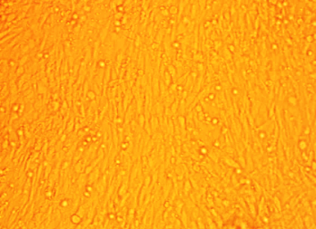
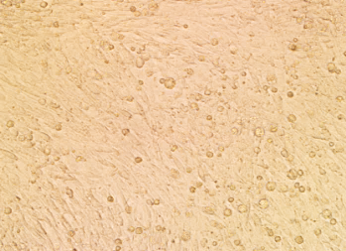
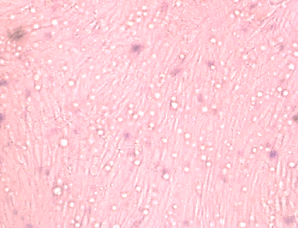
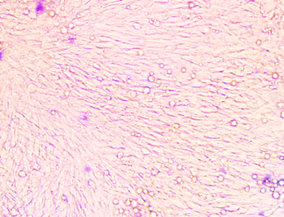
Images of negative control SH-EP1 cells
Confluent | 24 hrs | 48 hrs | 96 hrs | 96 hr trypan blue
Without oligomeric Aβ1-42 peptide
With oligomeric Aβ1-42 peptide
Scale bar 20 μm
Same for all images
SH-EP1 cells do not have nicotinic receptors.
These are used for the negative control condition.
Notes:
SH-EP1 cells (Adapted from Himgauri V. Naik’s Master’s Thesis 2014)

Slide 23
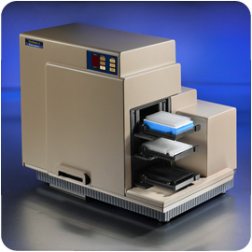
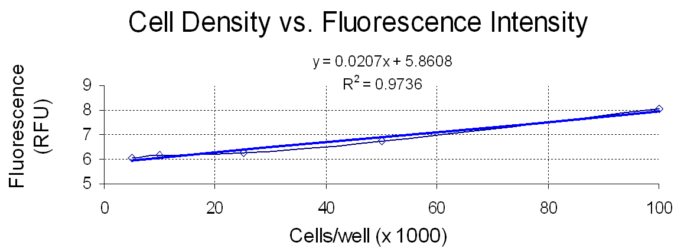
Cell-based assays using fluorescence
Changes in protein expression (mα7-YFP protein) in SH-EP1 cells
Plasma Membrane
Molecular Devices, 2008
FP-labeled proteins
Graphics: Teresa Murray 2007; plot: Murray, unpublished 2008

Slide 24
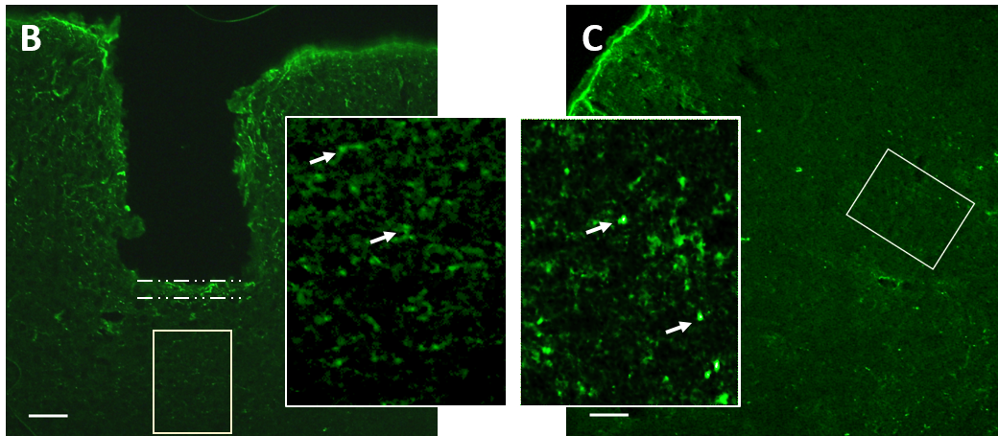
In vivo testing
Louisiana Tech University
College of Engineering and Science
g
h
Source: Lee, Murray, et al. 2016
Notes:
Adapted from Himgauri V. Naik’s Master’s Thesis 2014

Slide 25
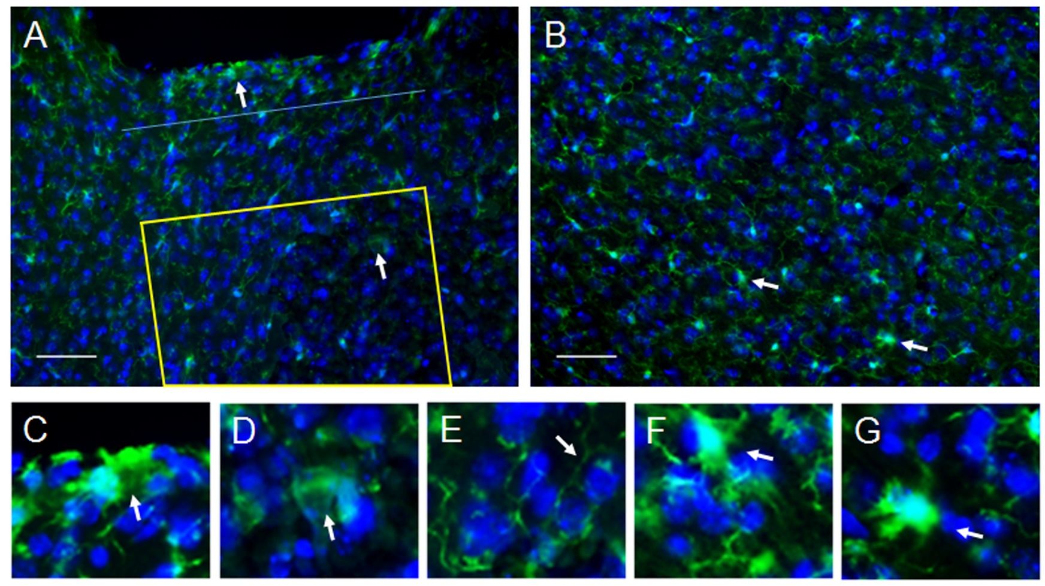
In vivo testing
Louisiana Tech University
College of Engineering and Science
g
Source: Lee, Murray, et al. 2016
Notes:
Adapted from Himgauri V. Naik’s Master’s Thesis 2014

Slide 26
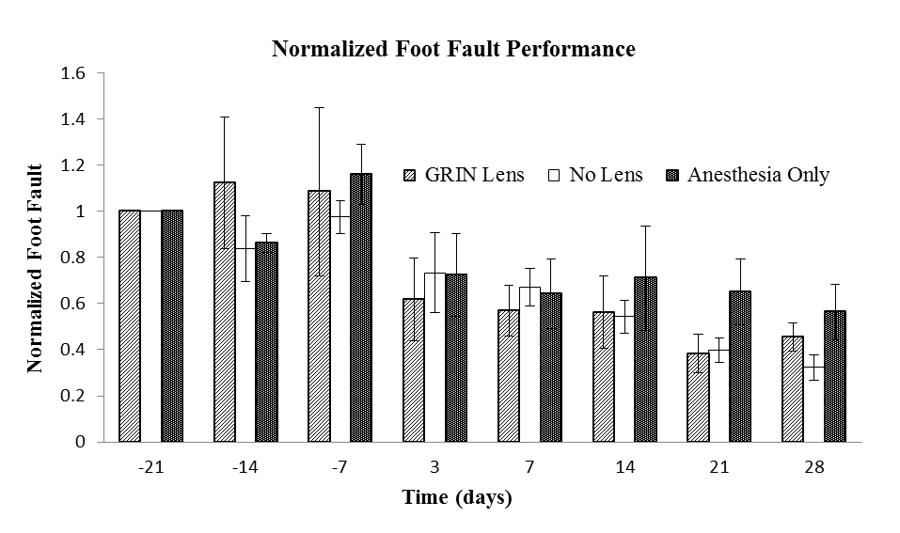
In vivo testing
Louisiana Tech University
College of Engineering and Science
g
h
Source: Lee, Murray, et al. 2016
Notes:
Adapted from Himgauri V. Naik’s Master’s Thesis 2014

Slide 27




Oxidized dextran S.A.M. on electrodes
No S.A.M.
S.A.M.
Cells (stained purple) adhered to electrode surface
No cells adhered to electrode surface
T Murray 2002, unpublished
T Murray 2002, unpublished
Extensive encapsulation and inflammation (red stain), few neurons (blue stain)
Thin capsule, more neurons
Antibody stain colors are:
Astrocytes Neurons
Murray, T.A., et al., REAS 2003
Murray, T.A., et al., REAS 2003
Poor signal to noise ratio, likely due to encapsulation and exclusion of neurons
Good S:N likely due to larger numbers of neurons
Notes:
Steve(?): You can get this directly from paper’s conclusions.

Slide 28



PI & Fluorescent Nissl Stain
Dyes used to show neurons (green) and damaged cells (red)
after removal of GRIN lens
Nissl stain
Propidium iodide
Colocalized (white)
Murray, 2010, unpublished
Notes:
20110108_PI_Nissl_Implant_2_5a_350um_830nm_3X_065_YFP_1Ch_green
20110108_PI_Nissl_Implant_2_5a_350um_770nm_3X_066_PI_1Ch_red
20110108_PI_Nissl_Implant_2_5a_350um_3X_065_066_1Ch_RGW
Propidium Iodide Stain http://en.wikipedia.org/wiki/Propidium_iodide Propidium iodide (or PI) is an intercalating agent and a fluorescent molecule with a molecular mass of 668.4 Da that can be used to stain DNA. When excited with 488 nm wavelength light, it fluoresces red and can be detected with 562-588 nm band pass filter. Propidium iodide is used as a DNA stain for both flow cytometry to evaluate cell viability or DNA content in cell cycle analysis [1] and microscopy to visualise the nucleus and other DNA containing organelles. It can be used to differentiate necrotic, apoptotic and normal cells.[2] Propidium Iodide is the most commonly used dye to quantitatively assess DNA content. [3][citation needed] Propidium iodide (PI) binds to DNA by intercalating between the bases with little or no sequence preference and with a stoichiometry of one dye per 4–5 base pairs of DNA. PI also binds to RNA, necessitating treatment with nucleases to distinguish between RNA and DNA staining.[4] Once the dye is bound to nucleic acids, its fluorescence is enhanced 20- to 30-fold, the fluorescence excitation maximum is shifted ~30–40 nm to the red and the fluorescence emission maximum is shifted ~15 nm to the blue. Although its molar absorptivity (extinction coefficient) is relatively low, PI exhibits a sufficiently large Stokes shift to allow simultaneous detection of nuclear DNA and fluorescein-labeled antibodies, provided the proper optical filters are used. PI is suitable for fluorescence microscopy, confocal laser scanning microscopy, flow cytometry, and fluorometry. PI is membrane impermeant and generally excluded from viable cells. PI is commonly used for identifying dead cells in a population and as a counterstain in multicolor fluorescent techniques.[5]

Slide 29
Track of implanted EEG electrode
Fixed brain tissue
Paraffin embedded
H&E stain
Little disruption of surrounding tissue
NeuroNEM Epilepsy Project: Unpublished, K. Ponder, 2017. Scale bar is 100 μm.

Slide 30

Louisiana Tech University
College of Engineering and Science
You do not need to memorize the entire table, but know the three assessments highlighted in yellow.
Table from text: Ratner et al., 2004

Slide 31

Louisiana Tech University
College of Engineering and Science

Slide 32
Systemic Toxicity and Hypersensitivity
Louisiana Tech University
College of Engineering and Science
Physical breakdown of biomaterials
encapsulation of debris
transport to & build-up in liver and other organs
Toxicity from leached compounds
concentration [mg/kg]
compound- & tissue-dependent
length of exposure
Immunotoxicity and hypersensitivity
allergy (unpredictable)
intolerance – inherited sensitivity

Slide 33

Louisiana Tech University
College of Engineering and Science
increases immune-system responses to chemicals
local tissue inflammation response to chemicals
changes in DNA
local structure/function
Tables from text: Ratner et al., 2004

Slide 34

Louisiana Tech University
College of Engineering and Science
Tables from text: Ratner et al., 2004

Slide 35



Louisiana Tech University
College of Engineering and Science
Some test standards useful for testing biomaterials
(This is not a complete list)
c
Know that ISO 10,993-# standards are for biocompatibility tests
Tables from text: Ratner et al., 2004

Slide 36
Louisiana Tech University
College of Engineering and Science
The following slides contain prices for preclinical testing by a commercial laboratory. They perform tests on materials that will be used in applications to the FDA for premarket approval.
You only need to memorize information that is highlighted in yellow on the following tables of tests.

Slide 37
Louisiana Tech University
College of Engineering and Science
2010 Price List for Biocompatibility Testing
Actual price list from a testing laboratory with the company’s name redacted
Cytotoxicity – ISO 10993-5, USP <87>
Test Description | Test Code | Price
Agar Overlay cell culture assay
24 hours incubation, triplicate, L929 cells | CTX101 | $135.00
MEM Elution cell culture assay
MEM elution, 48 hours incubation, triplicate, L929 cells, 24 hr. extraction | CTX110 | $135.00
MEM elution, 72 hours incubation, triplicate, L929 cells, 24 hr. extraction | CTX115 | $135.00
MEM elution, titration, 4 dose levels, L929 cells | CTX125 | $290.00
MEM elution, Japan MHLW | CTX210 | Quote
MEM elution or Agar overlay, additional reads
Each study/set | CTX701 | $25.00
The next slides list many of the common tests used for preclinical studies of medical devices. Numerous tests relate to biomaterials. Not all are used for a particular device. Note, several of the tests cite a particular published standard for testing.

Slide 38
Louisiana Tech University
College of Engineering and Science
Raw Materials Characterization ISO 10993-12; ISO 10993-18
Test Description | Test Code | Price
Differential Scanning Calorimetry (DSC)
Sample preparation and analysis, each | DSC101 | $160.00
Fourier Transform Infrared Analysis (FTIR) | IRX110
FTIR sample analysis, each |  | $110.00
Sample preparation (extraction or KBr press), each |  | $35.00
Library search, each |  | $35.00
Physicochemical test, USP plastics USP <661>
If the nonvolatile residue is <5 mg then the residue on ignition is not required, per USP
Complete | PCT101 | $450.00
Includes water extraction, buffering capacity, heavy metals, nonvolatile residue, residue on ignition
Complete, without residue on ignition | PCT105 | $375.00
Includes water extraction, buffering capacity, heavy metals, nonvolatile residue
Extractable/Leachable Analytical Chemistry
ICP-MS, Full scan | CHX110 | Quote
GC-MS for Volatile organic compounds | CHX110 | Quote
GC-MS for Semi-volatile organic compounds | CHX110 | Quote
LC-MS for Non-volatile organic compounds | CHX110 | Quote

Slide 39
Louisiana Tech University
College of Engineering and Science
Toxicology & Biocompatibility (in vivo)– ISO 10993
Sensitization
Maximization (ISO)
Local Lymph Node Assay
Buehler Method
Maximization (Japan MHLW)
Irritation
Intracutaneous Reactivity (ISO)
Intracutaneous Toxicity (USP)
Primary Eye Irritation
Primary Skin (ISO)
Bladder Irritation
Vaginal/Mucosal Irritation
Intracutaneous Injection (Japan MHLW)
FHSA Skin Irritation
Systemic Toxicity
Systemic Injection
Material Mediated Pyrogen
Sub-Chronic Toxicity: Intravenous Toxicity with Histopathology
Sub-Chronic Toxicity: Intraperitoneal Toxicity with Histopathology
Implantation (ISO): 7, 14, 30, 60, or 90 days
USP Class III, complete: Includes intracutaneous irritation and systemic toxicity
USP Class VI, complete: Includes intracutaneous irritation, systemic toxicity, and 7 day implant
All of the prices for these tests are quoted

Slide 40
Louisiana Tech University
College of Engineering and Science
c
Genotoxicity – ISO 10993-3
Test Description | Test Code | Price
Ames Mutagenicity Tests, OECD 471, ICH S2A and S2B
Ames test: Solids
2 extracts, 5 strains, plate incorporation (Saline and DMSO) | GTX110 | $2,545.00
Ames test: Solids
5 strains, plate incorporation, one extract | GTX130 | $1,855.00
Ames test: Soluble chemicals
5 strains, 1 dose, plate incorporation | GTX140 | $1,855.00
5 strains, 5 doses, plate incorporation | GTX145 | $3,975.00
Ames test: Base Oils, ASTM E1687-98
Pre-incubation, 1 strain | GTX150 | $795.00
Chromosomal Aberration, OECD 473 (solid sample/device extraction)
Test utilizing CHO cells 1 extract | GTX210 | $9,010.00
Test utilizing CHO cells, 2 extracts | GTX220 | $12,720.00

